Slide 1


Slide 2


Slide 3
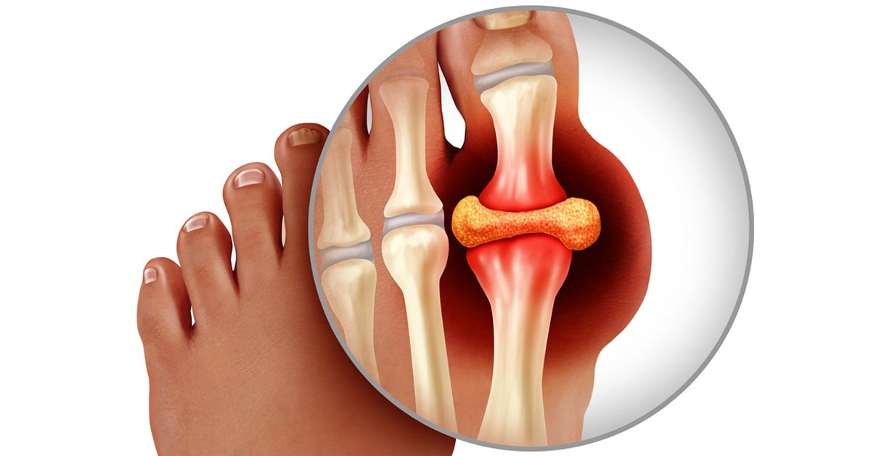

Slide 4
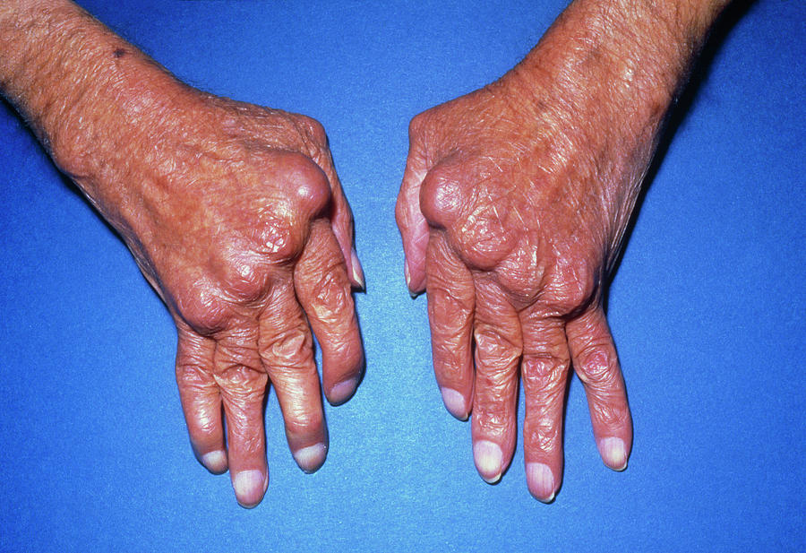

Slide 5
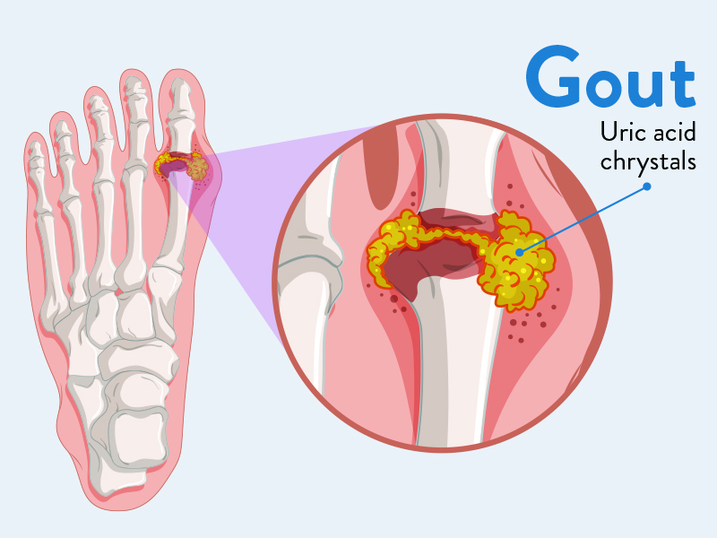
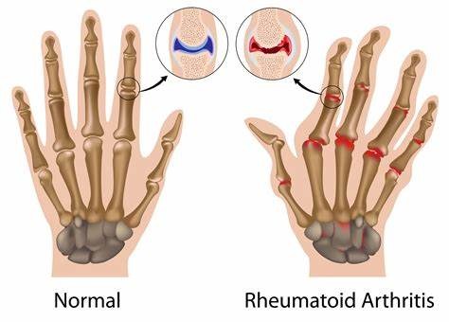
Gout And Rheumatoid Arthritis
Prepared by:
Bandana Tiwari
Roll no: 6
BNS 2nd year

Slide 6
General Objectives
At the end of the classroom session, BNS 1st year students will be able to explain about Gout and Rheumatoid arthritis (RA) .

Slide 7
Specific Objectives
At the end of this teaching session, the BNS 1st year will be able to :
define gout
state the classification of gout
list the causes of gout
explain the pathophysiology of gout

Slide 8
enlist the sign and symptoms of gout
enlist the diagnostic investigation of gout
explain the treatment procedure of gout
explain the nursing management of gout
list the complication of gout

Slide 9
define rheumatoid arthritis
list the causes of rheumatoid arthritis
enlist the sign and symptoms of rheumatoid arthritis
enlist the diagnostic investigation of rheumatoid arthritis
explain the treatment procedure of rheumatoid arthritis

Slide 10
explain the nursing management of rheumatoid arthritis
list the complication of rheumatoid arthritis
explain the prevention of rheumatoid arthritis

Slide 11

GOUT

Slide 12
Introduction
Gout is a metabolic disease characterized by episodes of acute and chronic arthritis caused by deposition of monosodium crystal around the joints and connective tissue : a red, tender, hot , swollen joints.
It is defined as “a disease characterized by an abnormal metabolism of uric acid , resulting in an excess of uric acid in the blood and tissue”.

Slide 13
It is commonly found in middle aged men and postmenopausal women.
The metatarsal – phalangeal joints at the base of the big toe is the most commonly affected ( approximately 50% of cases ).
Gout is resulting from hyperuricemia.

Slide 14
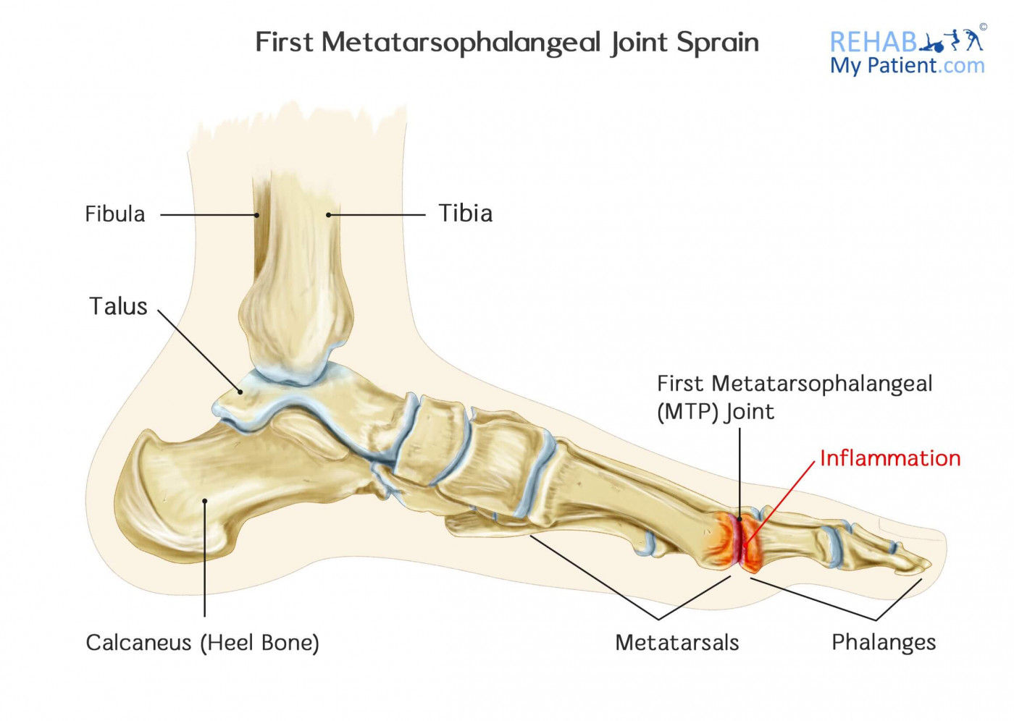

Slide 15
Classification
Primary gout:
It is associated with overproduction of uric acids and increased synthesis of purine nucleotides.
It is most likely result from combination of hormonal, genetic and dietary factors.
It consist of 90% of the cases.

Slide 16
Secondary gout
It is caused by drug therapy or by medical conditions other than an inborn metabolic disorder.
It is associated with increased production or impaired excretion of urates due to some disease like renal failure, ketoacidosis , hypertension , etc.

Slide 17
Risk factors of gout
Advancing age
Gender
Family history of the condition
Obesity
Heavy Alcohol consumption

Slide 18
cont…
Certain drug like thiazide diuretic, levodopa
Exposure to lead
Leukemia
Thyroid problems

Slide 19
Pathophysiology of gout
Causes
Increase level of uric acid
Serum uric acid levels exceeds their plasma saturation point
Formation of monosodium urates crystals within a joints
Inflammatory response

Slide 20
Acute gout attack
Repeated gout attack
Accumulation of sodium Urates crystals (tophi)
Deposited in body such as great toe, ears, renal system (urolithiasis)

Slide 21
Signs and symptoms
Hyperuricemia
Severe pain
Fever
Swollen, red and warm joint

Slide 22
Cont….
Tenderness in affected joint
Peeling and itching skin around the affected joint
Presence of the uric acid crystal in joint fluid
More than one attack of acute arthritis.

Slide 23
Diagnostic Investigation
History taking
Physical examination
Synovial fluid analysis of swollen joints
24 hour urine for uric acid level
Blood test : serum uric acid level , WBC, ESR
X- Ray

Slide 24
Medical treatment of gout
The goal of the treatment for gout consist of alleviating pain, avoiding severe attacks in the future and preventing long term joint damage.
NSAIDs
Colchicine(for acute gout)
Allopurinol(for chronic gout)
Steroids

Slide 25
Nursing Intervention
Give medicine as prescribed especially during acute attack.
Ice pack can be helpful in relieving pain and reducing inflammation.
Maintaining adequate hydration is key for minimizing the frequency and intensity of attack.
Encourage bed rest , but use a bed cradle to keep bed lines off sensitive, in inflamed joints.

Slide 26
Encourage the patient to perform technique that promotes rest and relaxation.
Provide nutrition rich food . Avoid purine rich foods.
Encourage the patient to perform as much as self care as his / her immobility and pain allow.
Discuss the patient about the principle of gradual weight reduction with an obese patient.
Provide emotional support during the diagnostic test and procedures.

Slide 27
Administer anti- inflammatory medications and other drugs, as ordered.
To promote the sleep, administer pain medication at the times that allow the maximum rest.

Slide 28
Complication of gout
Recurrent gout
Advanced gout
Kidney stone
Damage to joints
Gout might spread

Slide 29
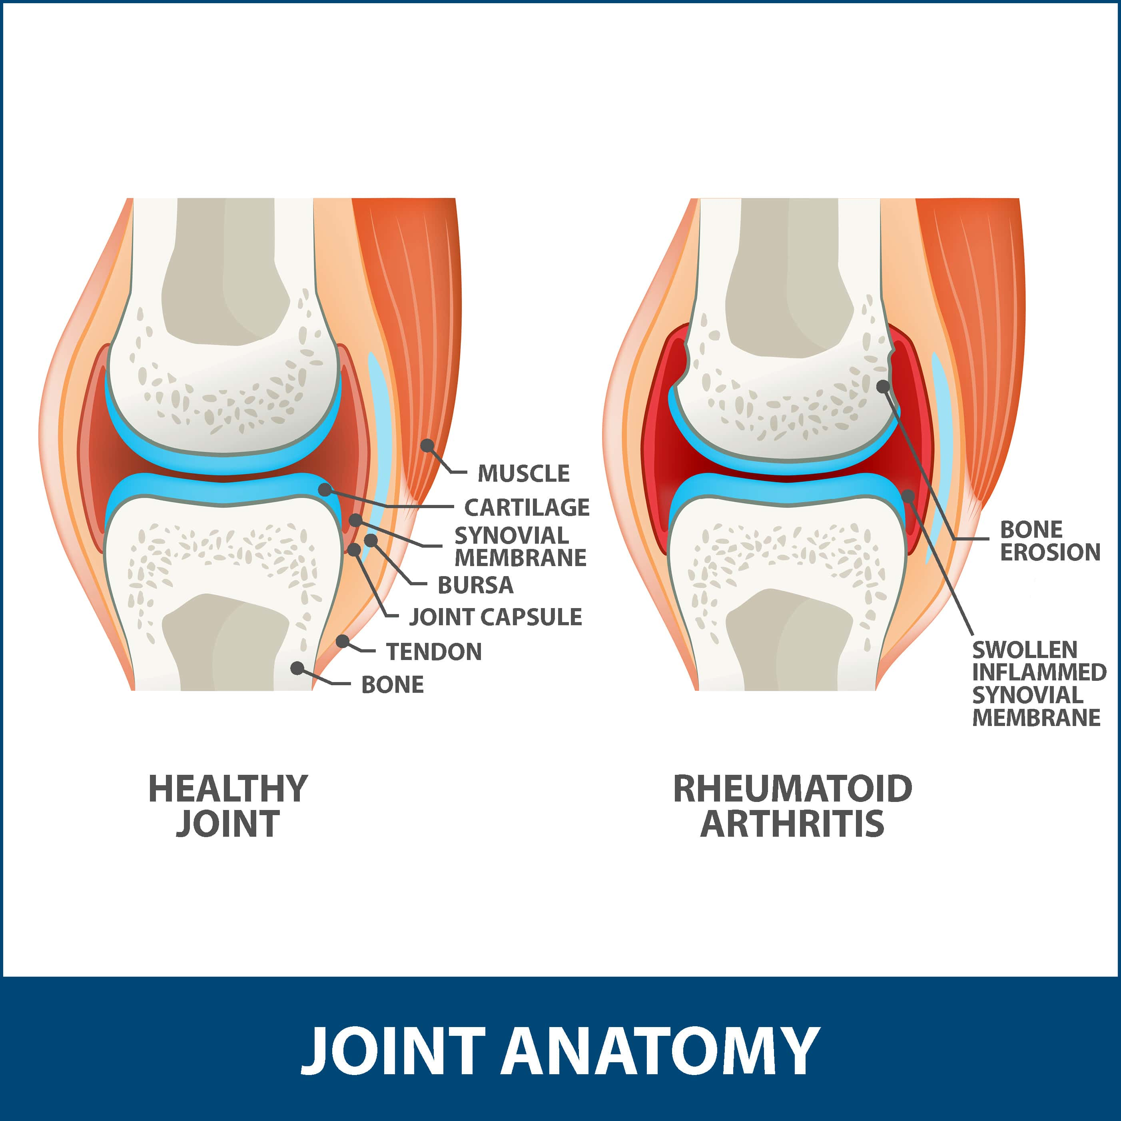
Rheumatoid Arthritis (RA)

Slide 30
Rheumatoid Arthritis (RA)
Rheumatoid arthritis (RA) is a chronic, systemic inflammatory disorder , that affect many tissues and organs but principally attacks the joints producing an inflammatory synovitis that often progresses to destruction of the articular cartilage and ankylosis of the joints.
It is a autoimmune disease in which the normal immune response is directed against an own tissue , including the joints, tendons and bones resulting inflammation and destruction of these tissue.

Slide 31
It is a chronic inflammatory polyarthritis which affect five or more joints.
It can happen in many different joints at the same time .
It also cause the problems with heart, muscle , blood vessel, nervous system and eyes.
About 1% of the world’s population is affected by rheumatoid arthritis, women are three times more often than men.
Onset is more frequent between the age of 40 and 50 , but people of any age can be affected .

Slide 32
The natural history of RA varies considerably with at least three possible disease courses:
Monocyclic: Have one episode which ends within 2-5 years of initial diagnosis and did not reoccur.
Polycyclic: The levels of disease activity fluctuate over the course of the condition.
Progressive: RA continues to increase in severity and is unremitting.

Slide 33
Causes
Exact cause is unknown
Hereditary
Infection
Obesity
Environmental factors e.g. smoking tobacco, chronic periodontal disease

Slide 34
Cont…
Hormone replacement therapy (HRT)
Menstrual history (i.e. early menopause)

Slide 35
Signs and symptoms
Joint inflammation
Stiffness
Swelling
Pain
Redness and warmth

Slide 36
Cont..
Fatigue
Malaise
Loss of appetite
Weight loss
Muscle aches
Hoarseness voice

Slide 37
Diagnostic investigations
History taking
Physical examination
Rheumatoid factors
X-Ray
Lab test : Erythrocyte sedimentation rate , Red blood cell, C-reactive protein

Slide 38
Management
Pharmacological management:
Non steroidal anti- inflammatory drugs (NSAID) such as ibuprofen, aspirin , diclofenac etc .
b) Disease modifying anti- rheumatic drug (DMARD) such as methotrexate, sulfasalazine etc.
c) Corticosteroid drugs such as prednisone

Slide 39
Surgical management
Synovectomy
Tender repair
Arthrodesis
Total joint replacement

Slide 40
Nursing management
Assessment
Assess for the joint stiffness and pain
Assess the intensity and chronicity of the joint deformities
Assess the level of fatigue
Asses the sleeping pattern of the patient including emotional status

Slide 41
Nursing diagnosis
Pain related to inflammation and increase disease activity or tissue damage .
Fatigue related to pain, inadequate sleep and emotional stress.
Impaired physical mobility related to decrease range of motion exercise.
Self care deficits related to fatigue or loss of motion

Slide 42
Cont..
Disturbed body image related to dependency imposed by chronic illness.

Slide 43
Nursing intervention
Relieving pain
Assess the level of pain
Encourage for verbalization of feeling about pain
Provide variety of comfort measures
Relaxation technique
Diversional therapy

Slide 44
Cont..
Heat and cold application
Administer anti-inflammatory and analgesic medicines
Massage
Rest

Slide 45
Decrease fatigue
Identify the physical and emotional factors about fatigue
Encourage sleep routine (warm bath and relaxation )
Explain the importance of rest for relieving articular and emotional stress.
Encourage to take adequate nutrition including source of iron from food and supplements.

Slide 46
Maintaining optimum functional activity
Encourage the verbalization regarding limitation in mobility
Assess the need for physical therapy
Encourage to do range of motion on affected joints
Promote use of assertive ambulatory device
Encourage independence in mobility

Slide 47
Provide ample times for activity
Achieving self care dependency
Provide assertive device
Reinforcement correct and safe use of assertive device

Slide 48
Adopting dependency
Help the patient identify the elements of control
Encourage patient to verbalize the feeling, perception and fear
Help to assess the present situation and identify problems
Assist to identify past coping mechanism

Slide 49
Complication
Carpal tunnel syndrome
Widespread inflammation
Joint damage
Cardiovascular disease
Cervical myelopathy

Slide 50
Prevention
Exercise
Get early help
Avoid high salt diet
Add more fish and omega -3 to your diet
Maintain vitamin D

Slide 51
Cont..
Avoid exposure to inhaled silica dusts
Quite smoking

Slide 52


Slide 53


Slide 54
Summarization
What do you understand about gout ?
Explain about treatment and nursing management of gout.
What do you understand about rheumatoid arthritis?
Explain about management of rheumatoid arthritis.

Slide 55
POST TEST
True or false(1*1)= 1
1) Gout is a metabolic disease.
True
2) Rheumatoid arthritis can happen in single joint.
False
Fill in the blanks (1*1)= 1
1) Gout is resulting from .......
Hypouricemia
Hyperuricemia

Slide 56
Home Assignment
Write short note on gout
What do you mean by Rheumatoid Arthritis? Write the management of Rheumatoid Arthritis.

Slide 57
Plan for next class
We will discuss about osteoarthritis and physiological changes in central nervous system.

Slide 58
References
Baral, R. Essential of Geriatric Nursing. Makalu publication.
Bruners and Siddharth, Medical Surgical Nursing, 10th edition.
Pradhan . M,K and Roka, A,T. (2015). Gerontological Nursing for BN/BSN Students (1st edition) Vidyarthi Prakashan
Subedi, P,S and Subba, K,H.(2019). A Textbook of Geriatric Nursing.(1st edition ). National Book Center.

Slide 59
Timalsina, R. (2077). Comprehensive Textbook of Geriatric Nursing.(3rd ed). Samiksha publication.
https://www.mayoclinic.org

Slide 60


